Slide 1
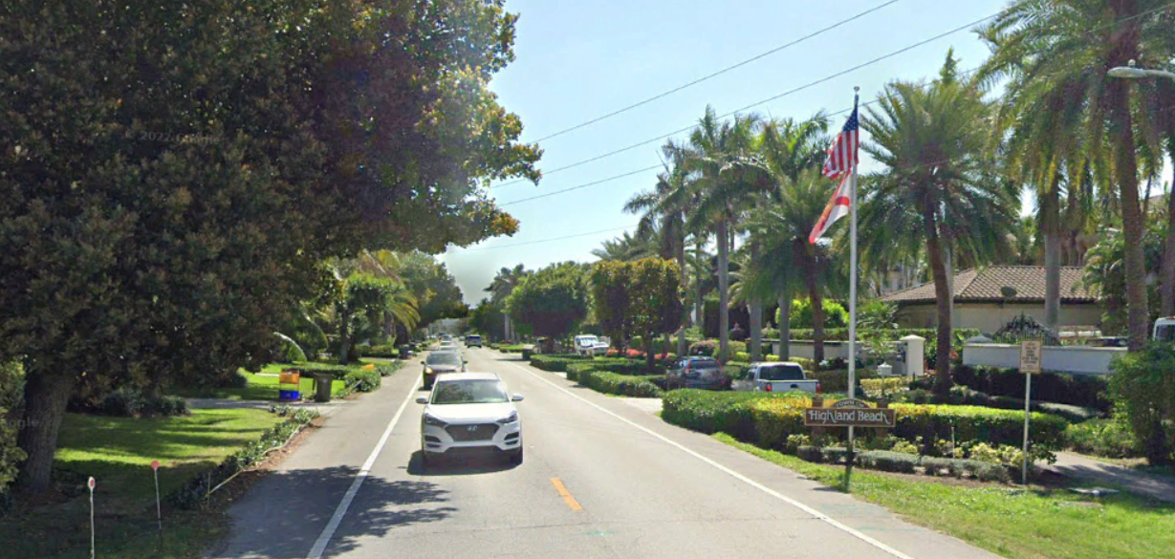
State Road A1A/Ocean Blvd from
South of Grand Court to South of Linton Blvd
Financial Management Number: 444477-1-52-01
Public Workshop
March 13, 2023

Slide 2
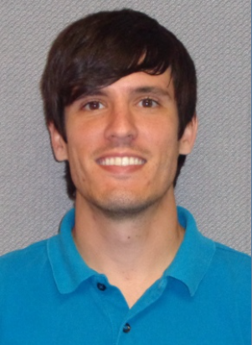
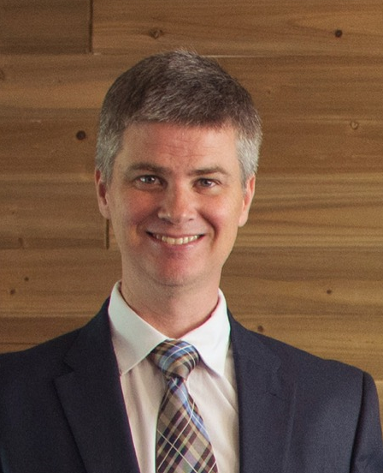
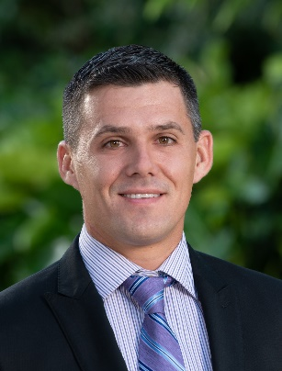
Meet the Team
Brad Salisbury, P.E.
Design Project Manager
FDOT
James Poole, P.E.
District Drainage Engineer
FDOT
Walna Calixte
Community Outreach Specialist
Infinite Source Communications Group
Billy Scott, E.I.
Roadway Designer
FDOT
Aaron Wilbur, PLA
Landscape Architect
Cotleur & Hearing

Slide 3
Non-Discrimination Policy

Slide 4
Project Location and Overview

Slide 5
Project Limits: State Road A1A/Ocean Blvd from South of Grand Court to South of Linton Blvd
Meeting Location
Highland Beach Library Community Room
Begin Project
Spanish River
Blvd
End Project
Linton
Blvd

Slide 6
Project Overview
Proposed Improvements:
Resurface roadway pavement
Minor (2 ft - 3 ft) widening to accommodate bicycles on the roadway shoulders
Extend Northbound Left Turn onto Linton Blvd
Improve drainage in swales
Upgrade signing and pavement markings to current standards
Project Length: 3.4 miles
Notes:
Congestion relief by adding a third westbound left turn lane
Mill and resurface the existing pavement
Restore skid resistance
Extend service life of the roadway
Upgrade the following to current standards:
Intersection lighting
Curb ramps
Signing & Pavement Markings

Slide 7
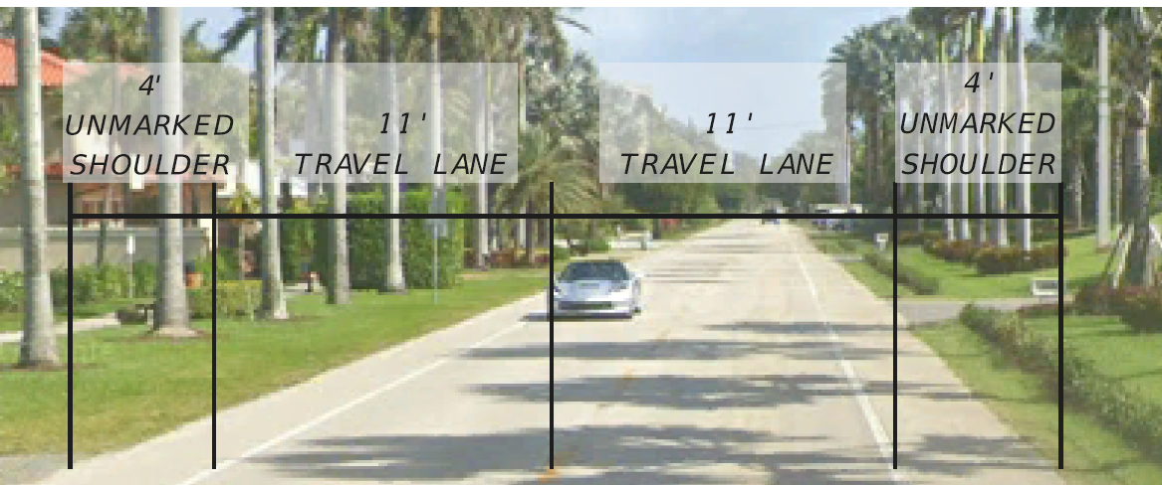
Existing Conditions

Slide 8
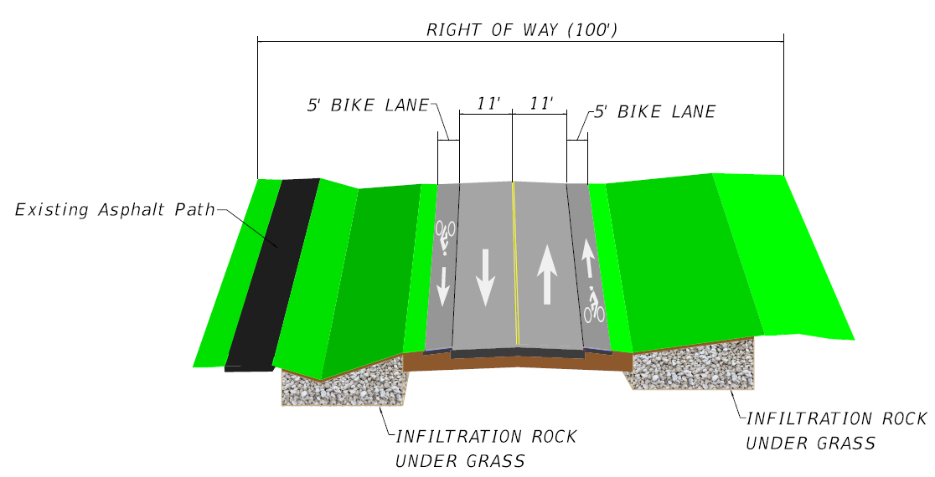
Proposed Improvements

Slide 9
Drainage Swale Detail

Slide 10
Temporary Traffic Control Plan
Work will be done in phases to reduce the impacts of construction in the community
Single lane closures will be done in segments
No greater than 1,000 feet of lane closure during daytime hours
No greater than 2,500 feet of lane closure during nighttime hours
Construction personnel will direct traffic during single lane closures to maintain two-way traffic
Pedestrian and vehicular access to all properties will be maintained at all times

Slide 11
Project Schedule and Cost
August 2022
February 2022
60% Plans
April 2023
90% Plans
Public Meeting
August 2023
100% Plans
Spring 2024
CONSTRUCTION BEGINS
Summer 2025
PROJECT COMPLETE
March 2023
Public workshop
Estimated Construction Cost: $8.8 Million

Slide 12
Additional Comments/Questions
Please submit your comments by September 10, 2022
Attendees are able to submit comments and questions in writing form using a comment sheet.
All comments and questions are part of the Public Record.
If your question was not responded to during the event, a response will be provided later.

Slide 13
Contact Information
If you have additional questions, please contact Brad Salisbury, P.E. –
FDOT Project Manager at:
Brad.Salisbury@dot.state.fl.us
3400 West Commercial Boulevard
Fort Lauderdale, Fl 33309
(954) 777-4160 or
Toll Free: (866) 336-8435; Ext. 4160

Slide 14
Thank you!
For attending the Public Workshop

